Slide 1

Loops: while; Updating variables
Python Programming | Loops, string, files, list, dictionaries and tuples
Course: Python Programming | Chapter: Loops, string, files, list, dictionaries and tuples | Program: Bachelor of Computer Science and Engineering
DISCOVER · LEARN · EMPOWER
Notes:
Welcome everyone to today's session on Python loops. We will focus specifically on the 'while' loop and the critical concept of updating variables. This is a foundational skill for controlling program flow in real-world applications. Let's begin by understanding how these loops function differently from other iteration methods.

Slide 2
Course Outcomes
SLIDE 2 / 14
Course Outcome
CO | BT LEVEL | DESCRIPTION
CO1 | BT1 | Understand the syntax, control structures, and basic constructs of Python programming language
CO2 | BT3 | Apply functions, modules, and exception handling for modular program development
CO3 | BT3 | Implement data structures including lists, tuples, dictionaries, and sets for efficient data processing
CO4 | BT4 | Analyze and manipulate files, strings, and perform data handling operations
CO5 | BT5 | Design and develop real-world applications integrating multiple Python concepts
Chandigarh University
2 / 14
Notes:
Today's lecture directly addresses two specific Course Outcomes. First, we will see how loops help analyze and manipulate strings and data structures. Second, we will learn how to design applications that integrate these looping concepts for practical problem solving. These outcomes ensure you can build robust software solutions.

Slide 3
Learning Objectives
SLIDE 3 / 14
Learning Outcomes
1
Analyze the execution flow of a while loop condition before iteration.
2
Evaluate the necessity of updating variables to prevent infinite loops.
3
Apply while loops to process strings and lists dynamically.
4
Design algorithms that safely terminate based on specific data criteria.
5
Demonstrate correct variable state changes within iterative logic blocks.
Chandigarh University
3 / 14
Notes:
By the end of this session, you will be able to analyze how a while loop checks conditions repeatedly. You will evaluate why updating variables is crucial to avoid infinite loops. We will apply these concepts to process strings and lists dynamically. Finally, you will design safe algorithms that terminate correctly based on data criteria.

Slide 4
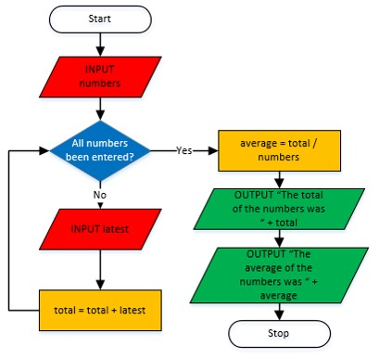
Lecture
SLIDE 4 / 14
Definition of While Loop
1
A while loop repeats a block of code as long as a condition remains true.
2
The condition is evaluated before every single iteration of the loop body.
3
If the initial condition is false, the loop body executes zero ×.
4
It is ideal for scenarios where the number of iterations is unknown.
5
Unlike for-loops, it does not automatically iterate over a sequence of items.
6
The loop continues until the boolean expression evaluates to False explicitly.
7
It provides flexible control over the termination logic of a program.
What Are the Types, Uses, and Benefits of Loops in Flowcharts?
Chandigarh University
4 / 14
Notes:
Think of a while loop as a bouncer at a club checking IDs. The bouncer checks the condition 'Is the person on the list?' before letting them in. If the condition is false initially, no one enters. This is perfect for situations where we don't know exactly how many × we need to repeat an action, like waiting for a user to type 'quit'.

Slide 5
Lecture
SLIDE 5 / 14
The Critical Role of Updating Variables
1
Updating variables changes the state of the loop control variable during execution.
2
Without updating, the condition never changes, causing an infinite loop error.
3
The update statement must logically move the variable toward the termination condition.
4
Common updates include incrementing counters or modifying string indices.
5
Failing to update leads to a program that hangs and consumes resources.
6
The update must occur inside the loop body to be effective.
7
Proper updates ensure the loop eventually reaches a state where it stops.
Chandigarh University
5 / 14
Notes:
Imagine a car stuck in neutral; the engine runs, but the car never moves forward. This is an infinite loop. The 'update' is like shifting gears to move the car. If you forget to update your counter variable, the condition remains true forever. You must ensure the update moves the variable closer to the stopping point, like reaching a target number.

Slide 6
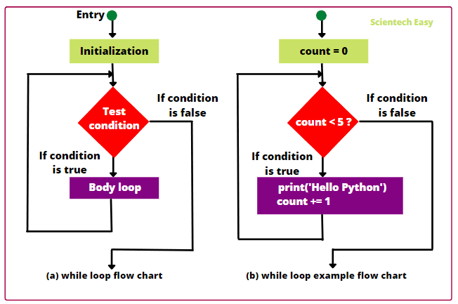
Lecture
SLIDE 6 / 14
Syntax Structure and Execution Flow
1
The syntax begins with the keyword 'while' followed by a boolean condition.
2
A colon ':' must immediately follow the condition to start the block.
3
The loop body requires indentation to define the scope of repeated actions.
4
Execution jumps back to the condition check after the body finishes.
5
The loop terminates only when the condition evaluates to False explicitly.
6
Indentation errors are a common cause of syntax errors in Python loops.
7
The condition is re-evaluated after every single iteration of the block.
Source: www.scientecheasy.com
Chandigarh University
6 / 14
Notes:
The syntax is strict: 'while' followed by a condition and a colon. The body must be indented to show it belongs to the loop. After the body runs, Python jumps back to the top to check the condition again. This cycle repeats until the condition becomes false. Always ensure your indentation is consistent to avoid syntax errors.

Slide 7
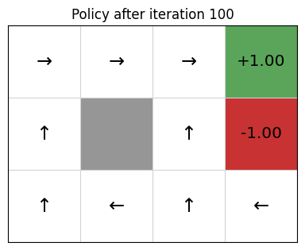
Worked Example
SLIDE 7 / 14
Summing Numbers
1
Initialize a counter variable 'i' to 1 and a sum variable 'total' to 0.
2
The condition 'i
3
Inside the loop, add the current value of 'i' to 'total'.
4
Update the counter by incrementing 'i' by 1 in each iteration.
5
The final value of 'total' will be the sum of integers 1 through 5.
6
This example demonstrates the standard pattern for counting and accumulating.
7
The loop stops when 'i' becomes 6, making the condition false.
Source: gibberblot.github.io
Chandigarh University
7 / 14
Notes:
Let's trace a simple sum. We start with i=1 and total=0. In the first pass, we add 1 to total, making it 1, then increment i to 2. We repeat this until i is 6. At that point, the condition 'i

Slide 8
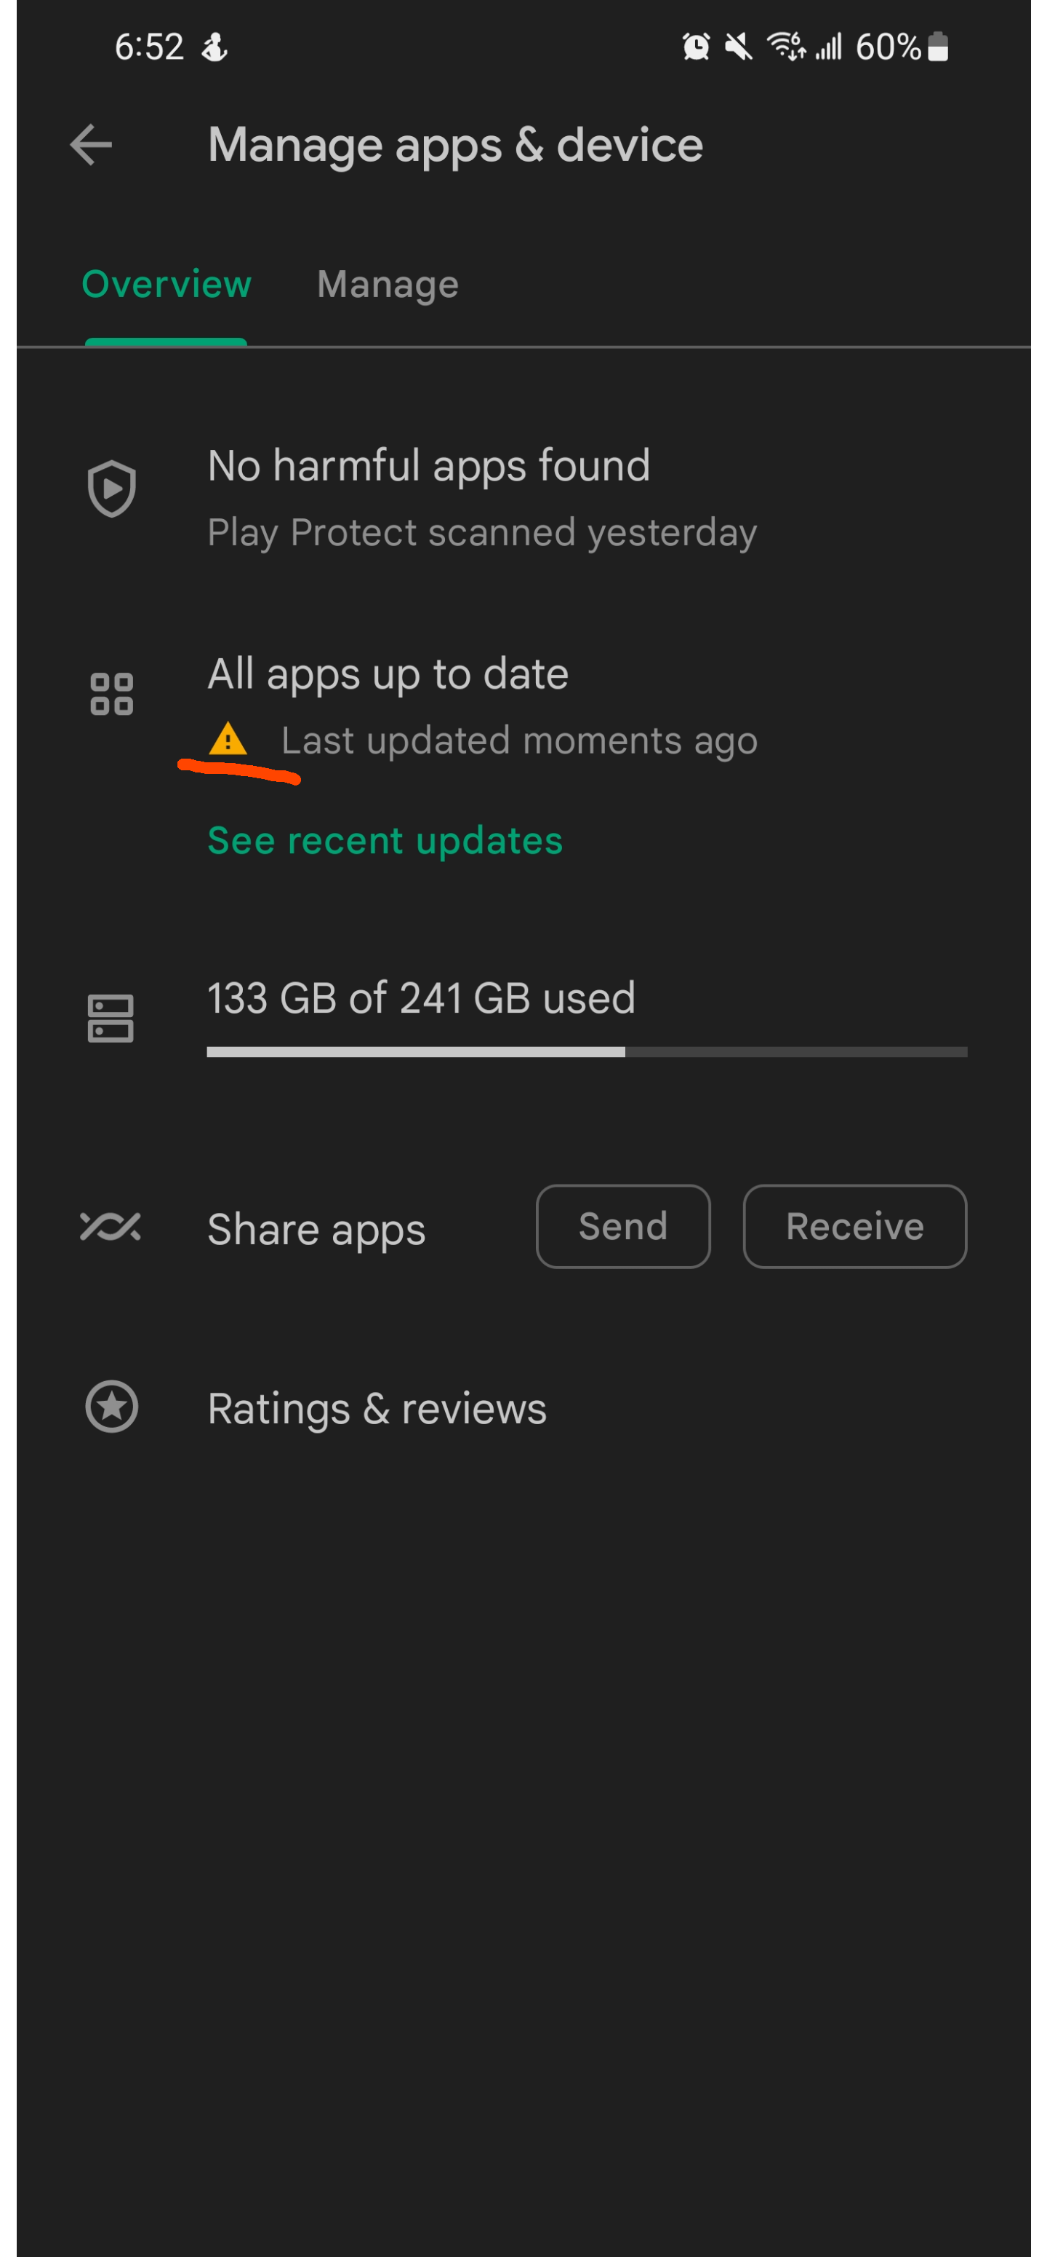
Common Pitfall
SLIDE 8 / 14
Infinite Loops
EXAMPLE
'while x < 10' without updating 'x' will never stop.
• An infinite loop occurs when the condition never evaluates to False.
• This usually happens if the update variable is missing or incorrect.
• The program will freeze and consume CPU resources indefinitely.
• Debugging requires checking if the update logic moves toward termination.
• Always verify that the update logic is reachable inside the loop body.
• Use a break statement as a safety net for unexpected conditions.
Source: preview.redd.it
Chandigarh University
8 / 14
Notes:
The most common mistake is forgetting to update the variable. If you write 'while x < 10' but never change x, the loop runs forever. This freezes your program. To debug, check if the update statement is inside the loop and if it logically moves the variable toward the stopping condition. Always have a safety break if the logic is complex.

Slide 9
Application
SLIDE 9 / 14
Processing Strings
1
While loops are ideal for processing strings character by character.
2
Use an index variable to track the current position in the string.
3
The condition checks if the index is less than the string length.
4
Update the index by incrementing it to move to the next character.
5
This allows custom logic for each character without using built-in methods.
6
You can count specific characters or reverse the string manually.
7
This approach gives granular control over string manipulation tasks.
Chandigarh University
9 / 14
Notes:
Consider processing a string like 'Hello'. You can use a while loop to check each character. Start with an index of 0 and check if it is less than the string length. Inside the loop, you can check if the character is a vowel. Then, update the index to move to the next character. This gives you full control over the processing logic.

Slide 10
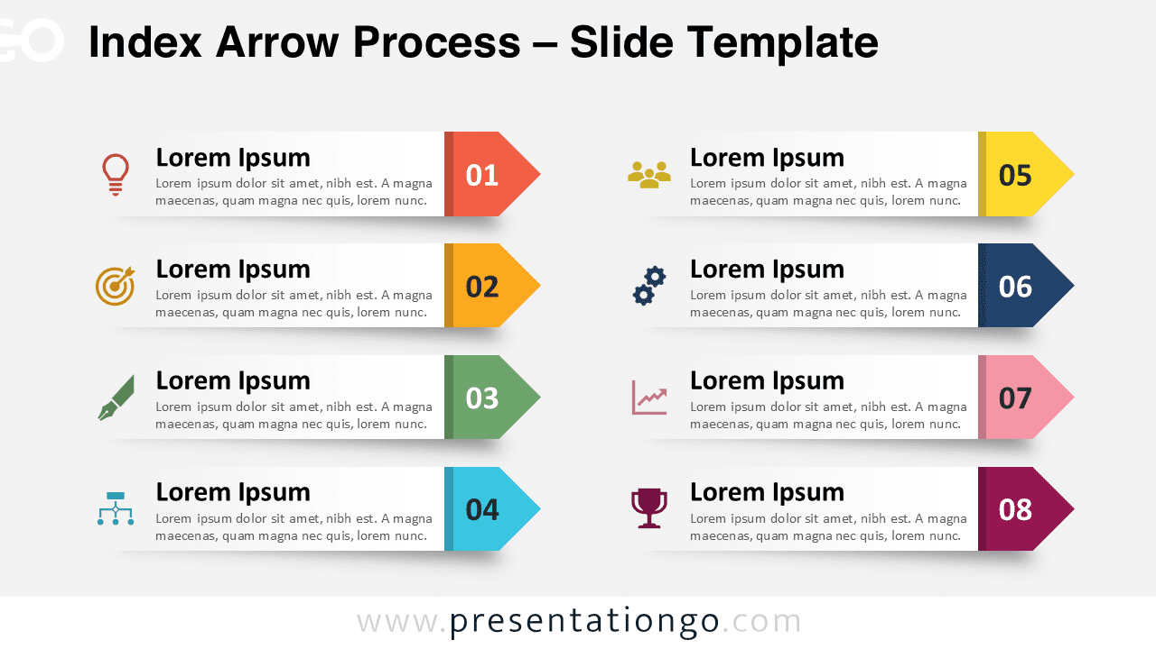
Application
SLIDE 10 / 14
List Traversal
1
While loops can traverse lists using an index-based approach.
2
Initialize an index to 0 and check if it is less than list length.
3
Access list elements using the current index variable for processing.
4
Update the index to move sequentially through the list items.
5
This method is useful when you need to modify elements in place.
6
It allows skipping specific items based on conditional logic during traversal.
7
It provides an alternative to the standard for-loop iteration mechanism.
Source: images.presentationgo.com
Chandigarh University
10 / 14
Notes:
You can also use while loops to traverse lists. Start with an index of 0 and check if it is less than the list length. Access the element at that index and perform your logic. Then, update the index to move to the next item. This is particularly useful if you need to modify elements in place or skip items based on specific conditions.

Slide 11
Worked Example
SLIDE 11 / 14
Finding a Character
GOAL
Find the index of the first occurrence of 'a' in a string.
• Initialize index 'i' to 0 and a flag 'found' to False.
• Loop while 'i' is less than string length and 'found' is False.
• Check if the character at 'i' matches the target character.
• If match found, set 'found' to True to stop the loop.
• Update 'i' by incrementing it by 1 in every iteration.
• The loop terminates immediately upon finding the target character.
Chandigarh University
11 / 14
Notes:
Let's find the letter 'a' in 'banana'. We start at index 0. If the character is not 'a', we increment the index. If we find 'a', we set a flag to True. The loop condition checks this flag. Once found, the loop stops immediately. This demonstrates how updating variables and conditions work together to optimize search operations.

Slide 12
Updating Variables
SLIDE 12 / 14
Best Practices
1
Always initialize the control variable before the loop starts.
2
Ensure the update statement is inside the loop body, not outside.
3
Use clear variable names that reflect the update logic purpose.
4
Avoid modifying multiple variables simultaneously unless the logic is clear.
5
Test edge cases where the loop might terminate on the first iteration.
6
Document the update logic to explain how the loop terminates.
7
Use break statements to exit early if a specific condition is met.
Chandigarh University
12 / 14
Notes:
Best practices include initializing your variable before the loop starts. The update must be inside the loop body; otherwise, it won't work. Use clear names for your variables so the logic is obvious. Always test edge cases, like when the loop should stop immediately. Documenting your update logic helps others understand how the loop terminates.

Slide 13
Lecture
SLIDE 13 / 14
Key Takeaways
1
While loops repeat code based on a condition evaluated before each iteration.
2
Updating variables is mandatory to prevent infinite loops and ensure termination.
3
The update logic must move the control variable toward the false condition.
4
While loops are powerful for processing strings and lists with custom logic.
5
Proper initialization and indentation are critical for correct loop execution.
Chandigarh University
13 / 14
Notes:
To summarize, while loops repeat code based on a condition checked before each iteration. Updating variables is mandatory to prevent infinite loops. The update logic must move the control variable toward the false condition. These loops are powerful for processing strings and lists with custom logic. Always ensure proper initialization and indentation for correct execution.

Slide 14
Lecture
SLIDE 14 / 14
References
PYTHON
A Practical Learning Approach, 1st Edition — T.S. Murugesh, Shriram K. Vasudevan, Sini Raj Pulari
• Learning Python, 6th Edition — Mark Lutz
• Starting Out with Python, Global Edition, 6th Edition — Tony Gaddis
• Introduction to Python Programming and Data Structures, 3rd Edition — Y. Daniel Liang
Chandigarh University
14 / 14
Notes:
These four books provide comprehensive coverage of Python programming and data structures. Mark Lutz's book offers deep insights into the language. Tony Gaddis provides excellent introductory examples. Y. Daniel Liang focuses on data structures, and the practical approach book offers hands-on exercises. Please refer to these texts for further study.

